Slide 1

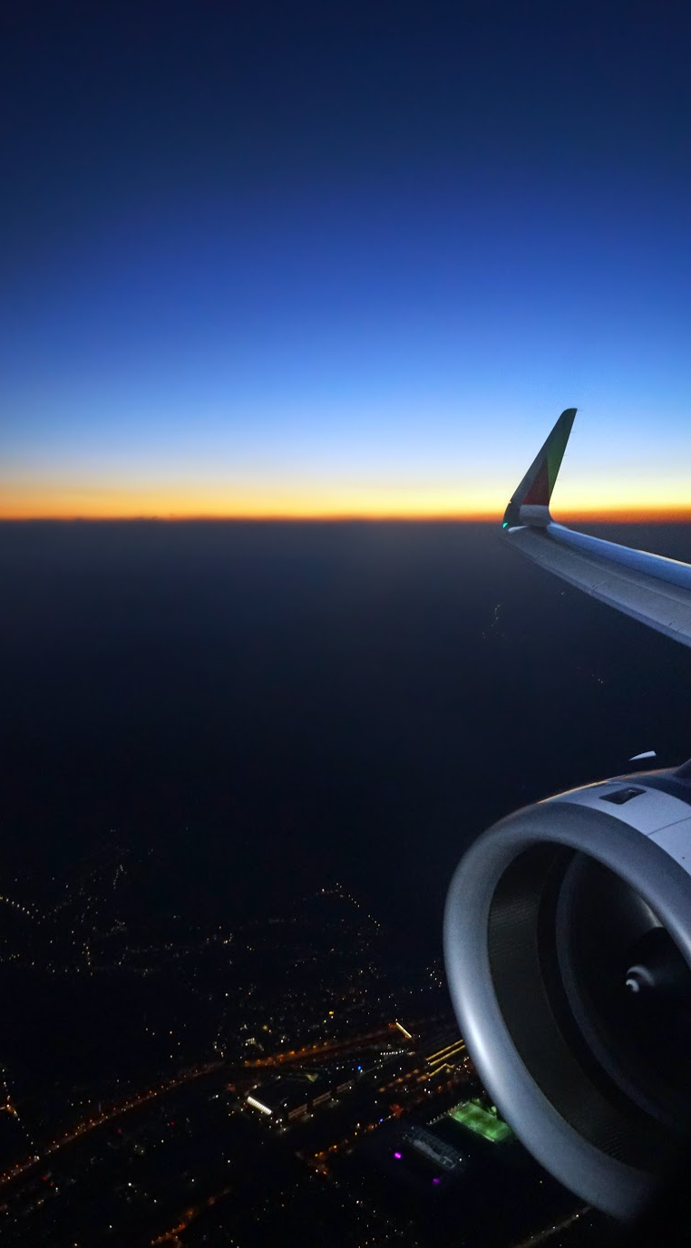



Domestic Airline Analysis
Team Rocket Consulting
Namita Ramesh, Matt Zlotnik, Thiru Vinayagam, Prathik Ullur, Arjun Rao

Slide 2
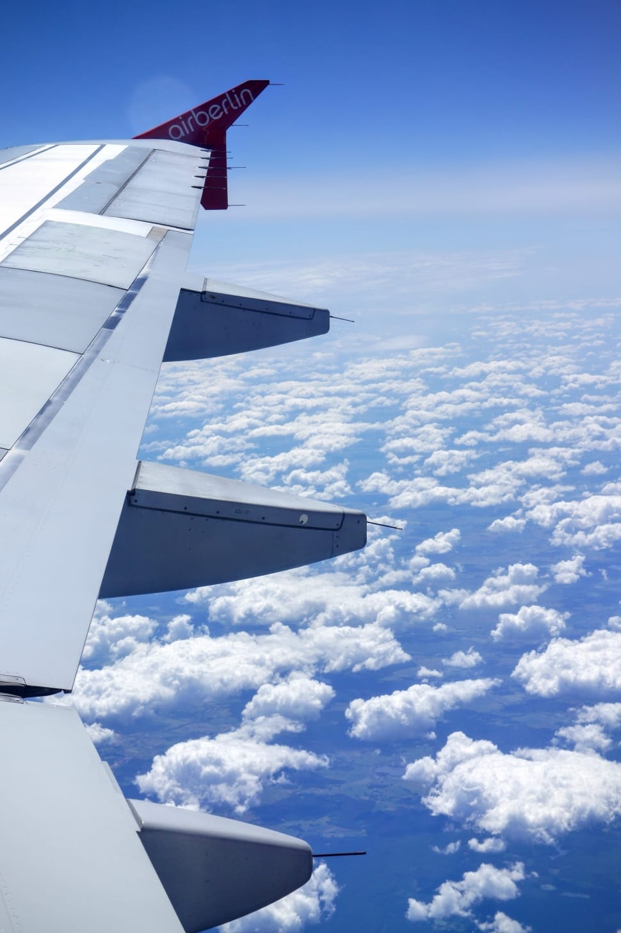

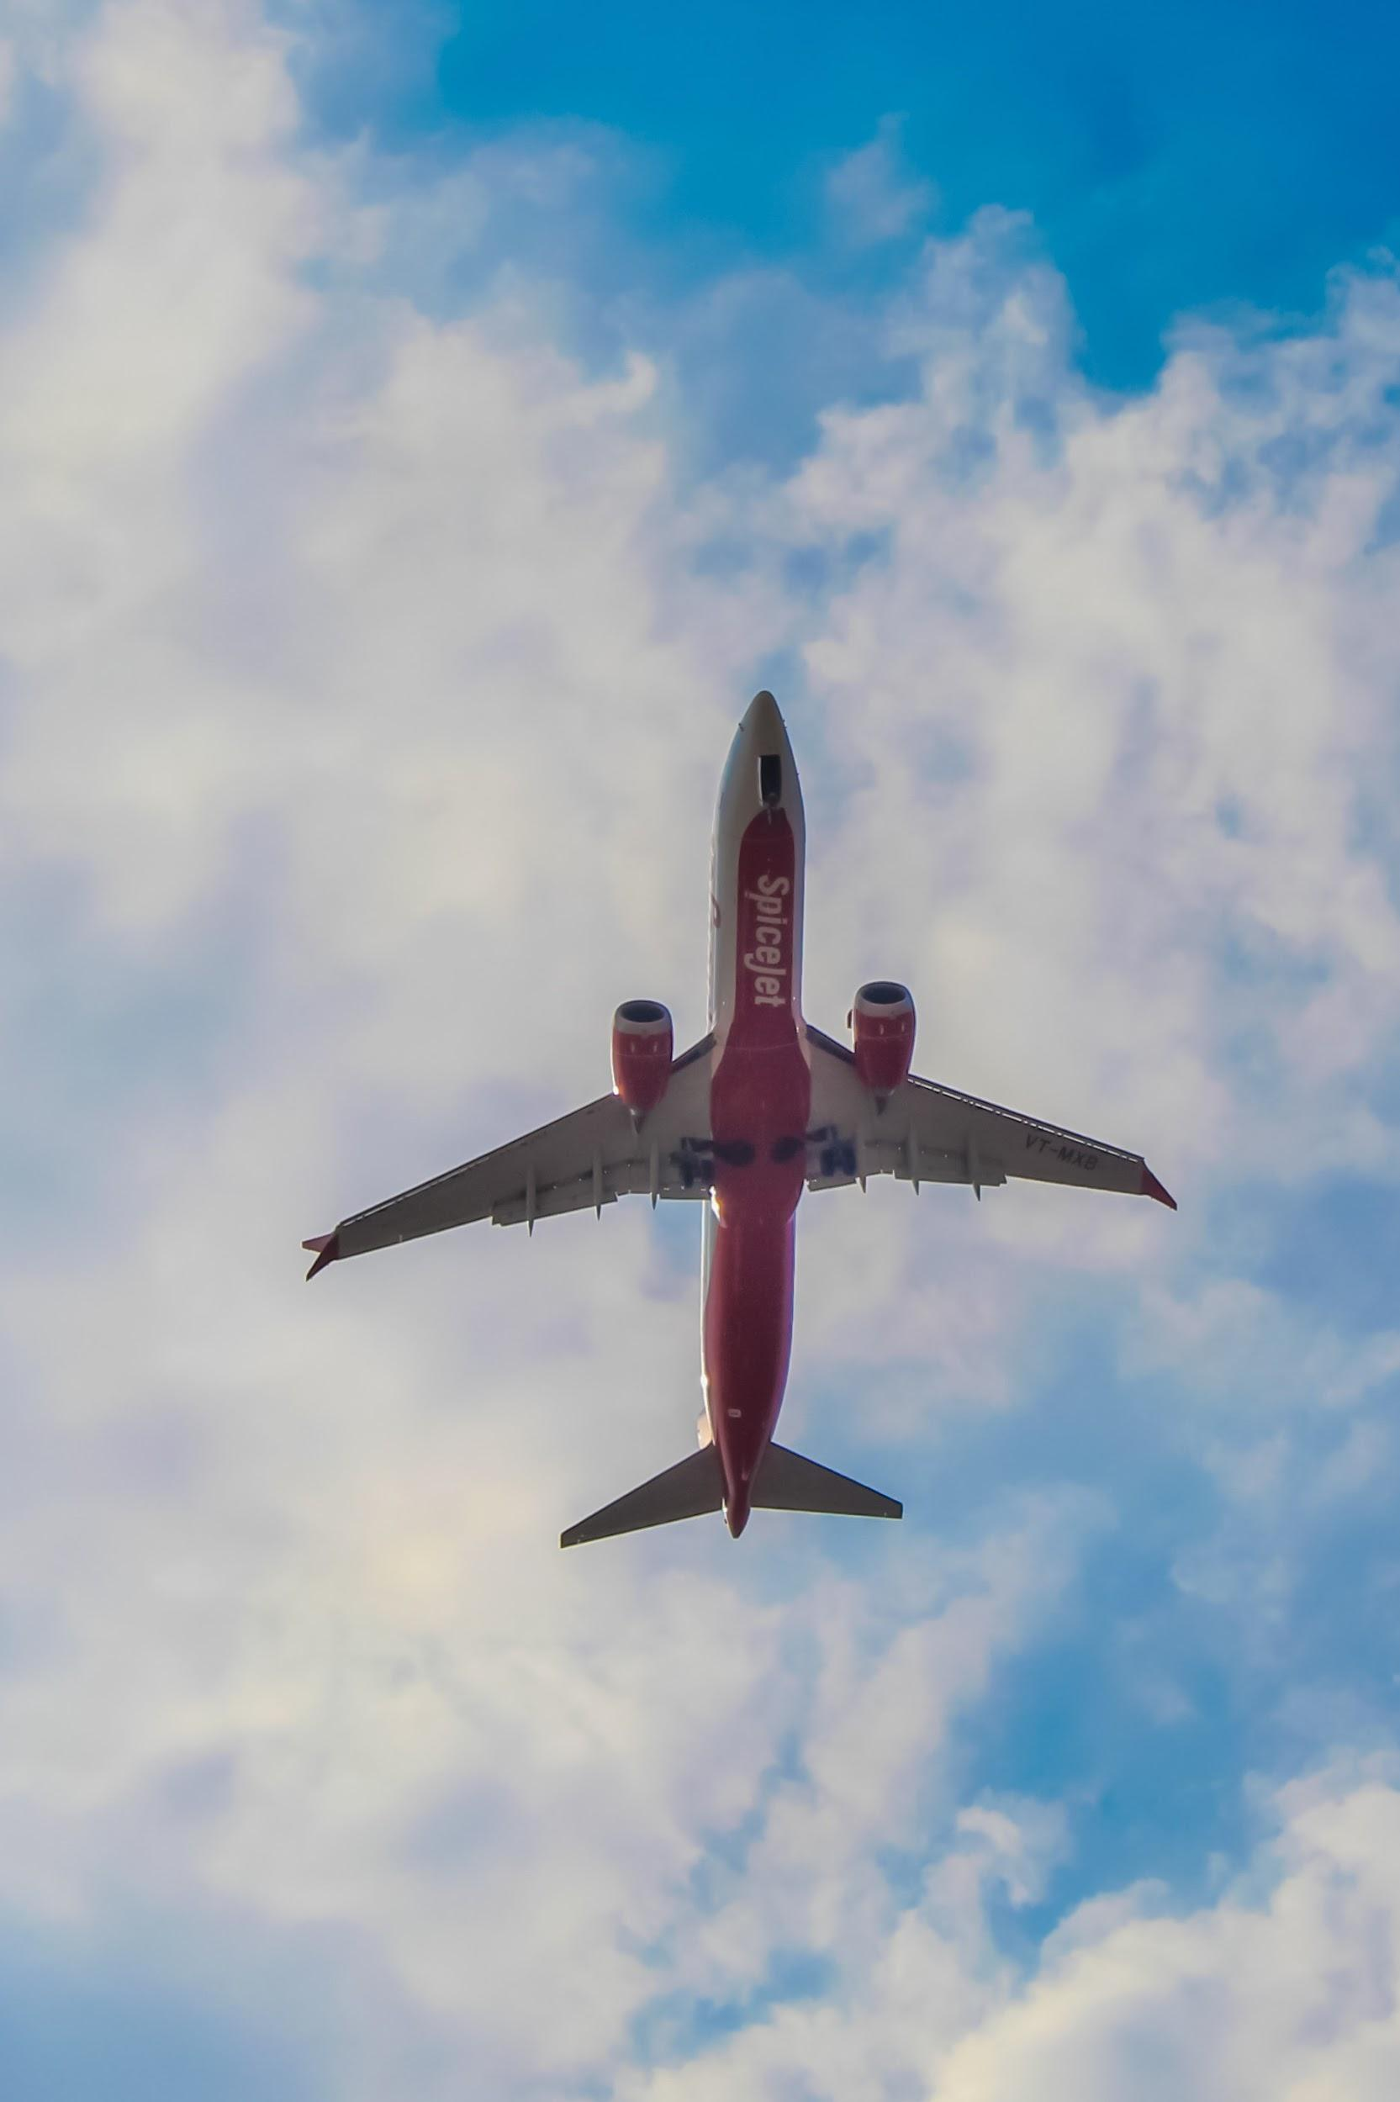







Agenda
Background
Project goals
Dataset
Data processing
EDA
Client cases
Recommendations

Slide 3





Background
Airline delays are a logistical and financial problem to passengers, airlines, and governing bodies like the FAA.
Identifying locations and causes of delays
Taking preventative measures and mitigating the risks
Additionally, knowledge of these risks can help travel aggregators plan campaigns based on historical prices

Slide 4
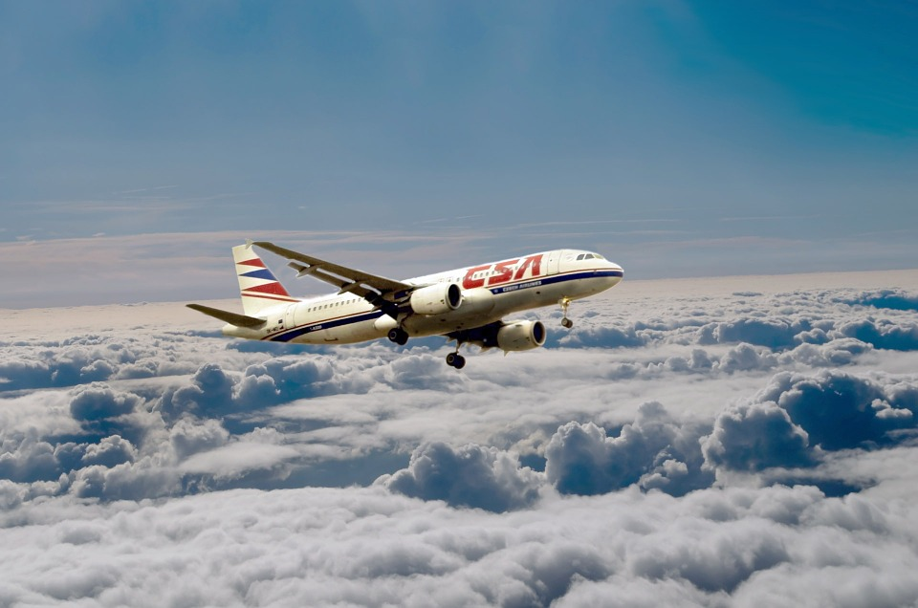





Team Rocket Consulting-
Project Goals
Perform information analysis for target clients and provide actionable insights:
Southwest Airlines
Kayak
Personal Goals:
Real life, non-Kaggle, raw data
Large amounts of public data
Data= $$$
Database building
Notes:
Simulate information analysis as consultant:
provide actionable insights as for potential clients. For this project we chose Southwest and Kayak
Apply concepts we learned in hte class to
unorganized big data set, not kaggle
Show that we could use unstructured public data to provide valuable information for clients and that data=$$$
build our own data base. Tables: start-end-time informmation
longitude/latitude
prices

Slide 5


Dataset and Cleanup

Slide 6









Data...Data...Data...
Reporting Carrier On-Time Performance
Airline Ticket Fare
Aug 2016 to Aug 2019
35 GB ⇒ 5GB (20 million rows)
Notes:
Our data set was collected from the Bureau of Transportation website
Openflights.com data on airport name and coordinates
Data
each month has over 300,000 rows and 35 columns -> 37 CSVs/months

Slide 7







Database
Analysis
Spark SQL Query for different projects
Consolidate raw data to yearly dates and filter certain variables
Consolidate information into our database.
Merge tables

Slide 8


Exploratory Data Analysis
Data Analysis
Click The Dashboard

Slide 9

Client Case 1- Kayak

Slide 10
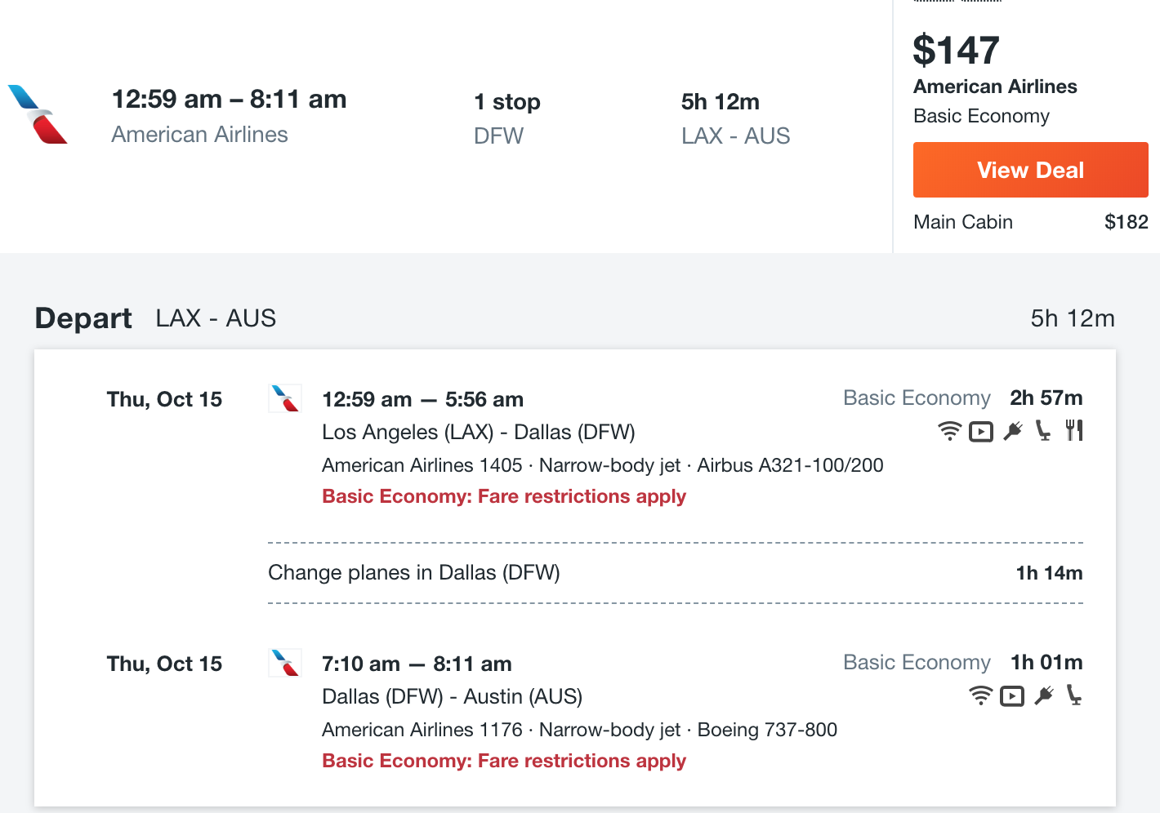

Users on Kayak
Delay Information??
Input : Origin, Destination, Month

Slide 11



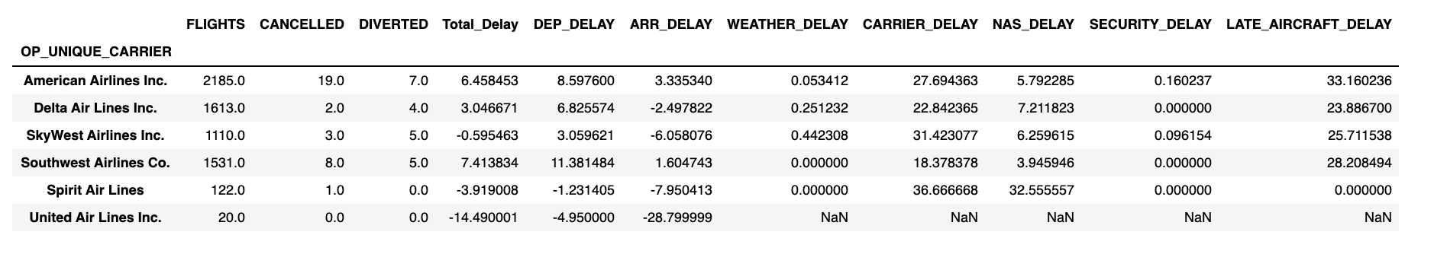
For each Airline flying that route, obtain :
Number of Flights,
Number of Cancelled Flights,
Number of Diverted Flights
Average Delay for each airline
Query Database for given route and month...

Slide 12
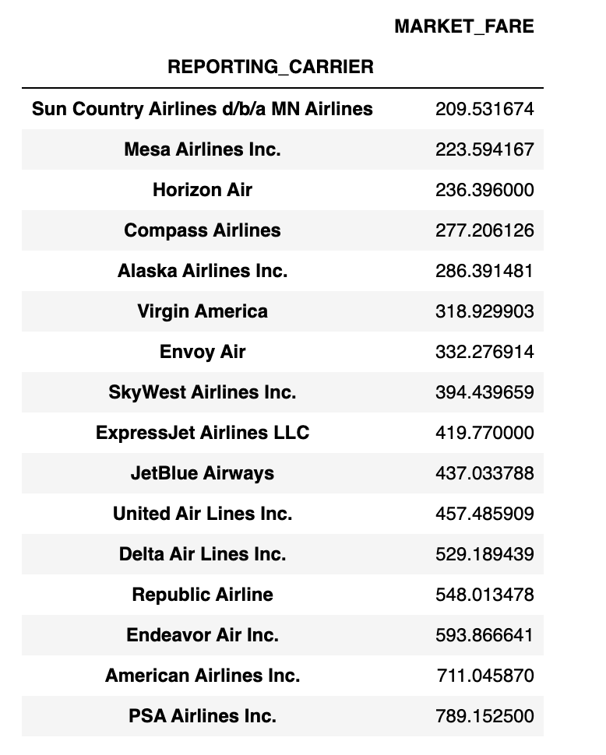
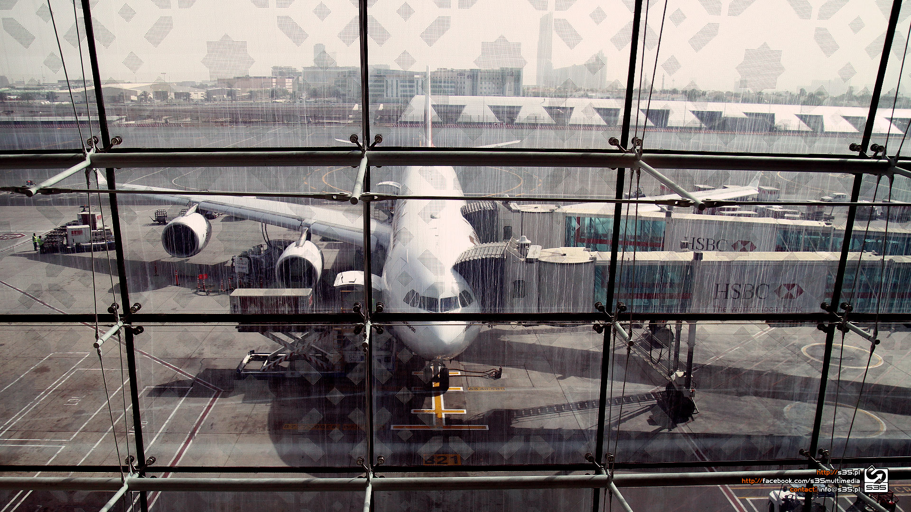
Average Ticket Price for each Airline for that route

Slide 13
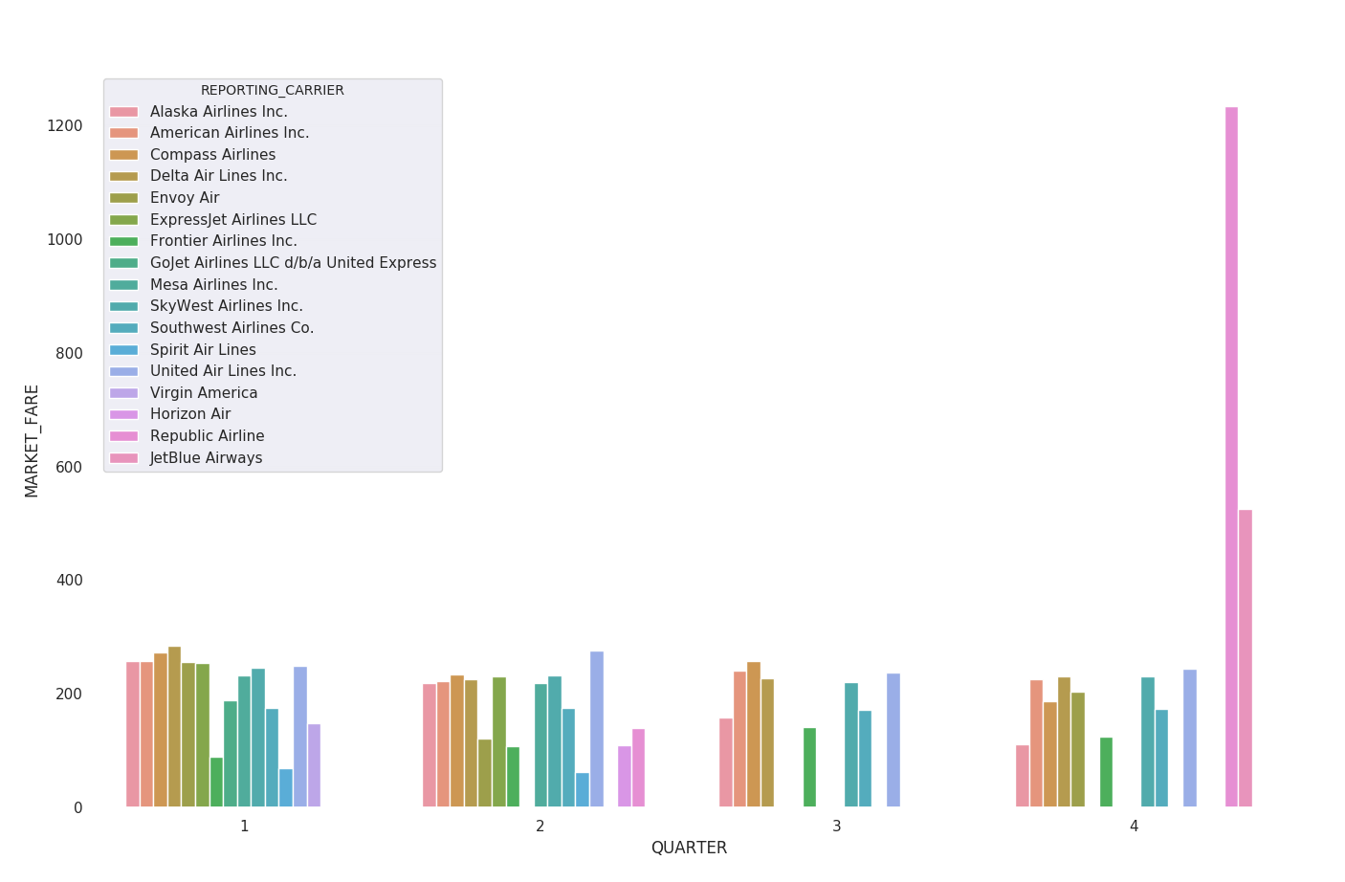
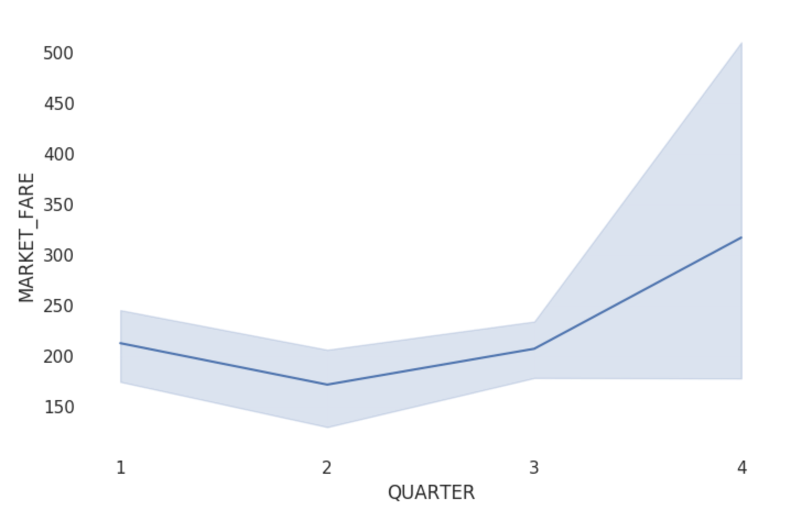
Average Market Fare trend for each Airline for a given route

Slide 14
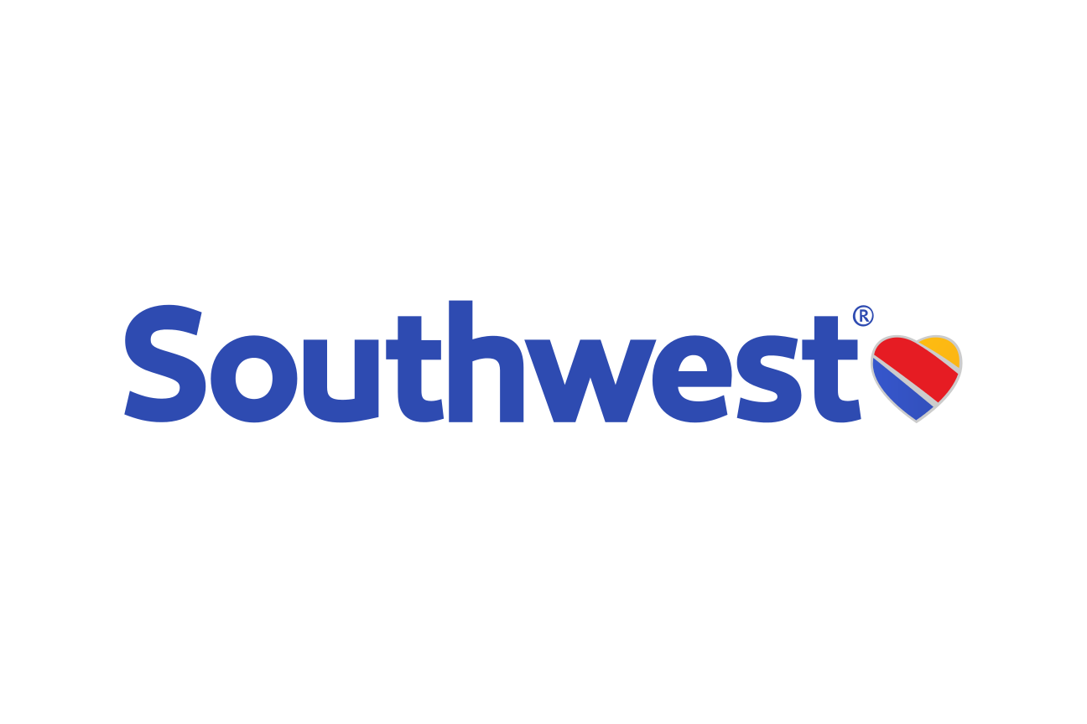
Client Case 2- Southwest

Slide 15



Most Delayed Routes
Motivation: Limited capital (human and financial) means decreasing costs on the most delayed routes creates the largest Return on Investment
Goal: To display the worst performing routes
Key Performance Metric: Weighted Average Total Delay
Notes:
60% Arrival Delay, 40% Departure Delay

Slide 16
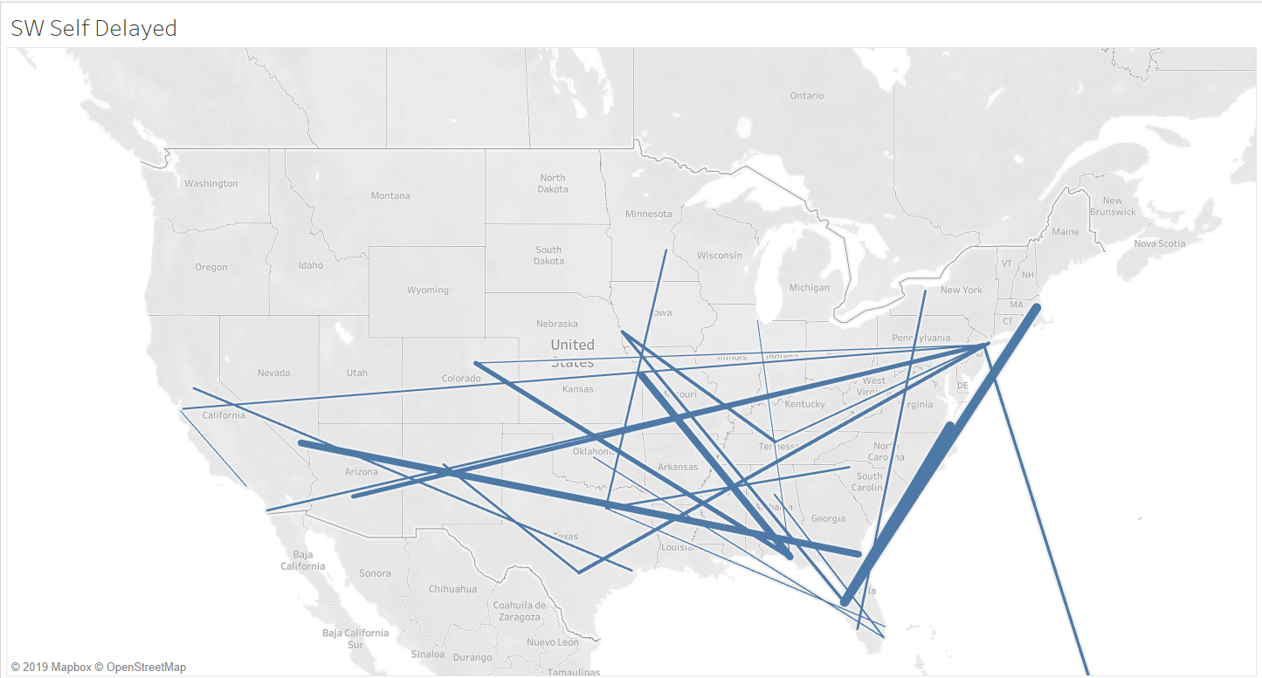

Slide 17
Flight Volume Recommendation System
Motivation: There is fierce competition between the 4 major airlines and decreasing market share for another airline is beneficial for our bottom lines
Goal: To find routes where we can potentially decrease competitor market share on a contested route
Key Performance Metric - Total Delay per Flight Volume for a Route
Notes:
Results: We found over 100 routes for each airline where they should add more flights to box out competitors

Slide 18
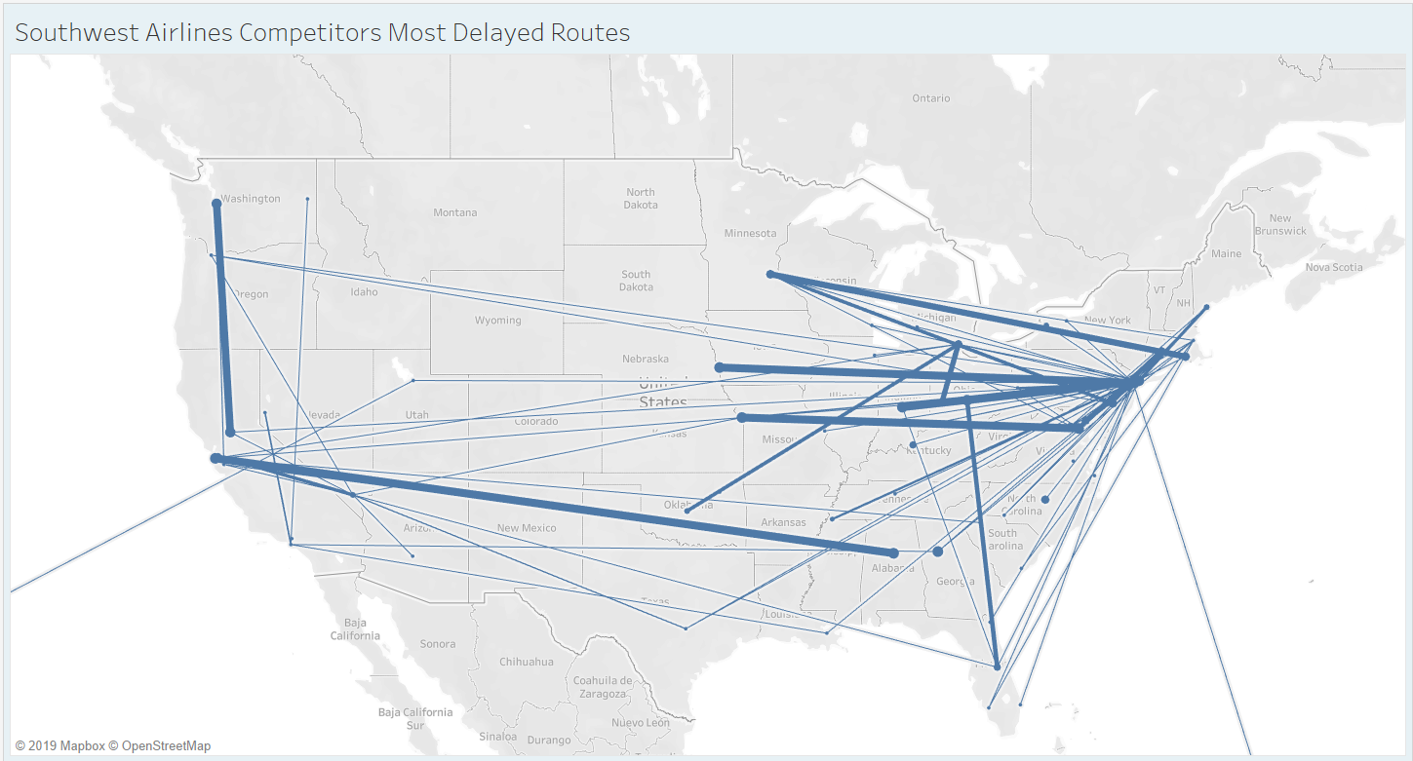

Slide 19
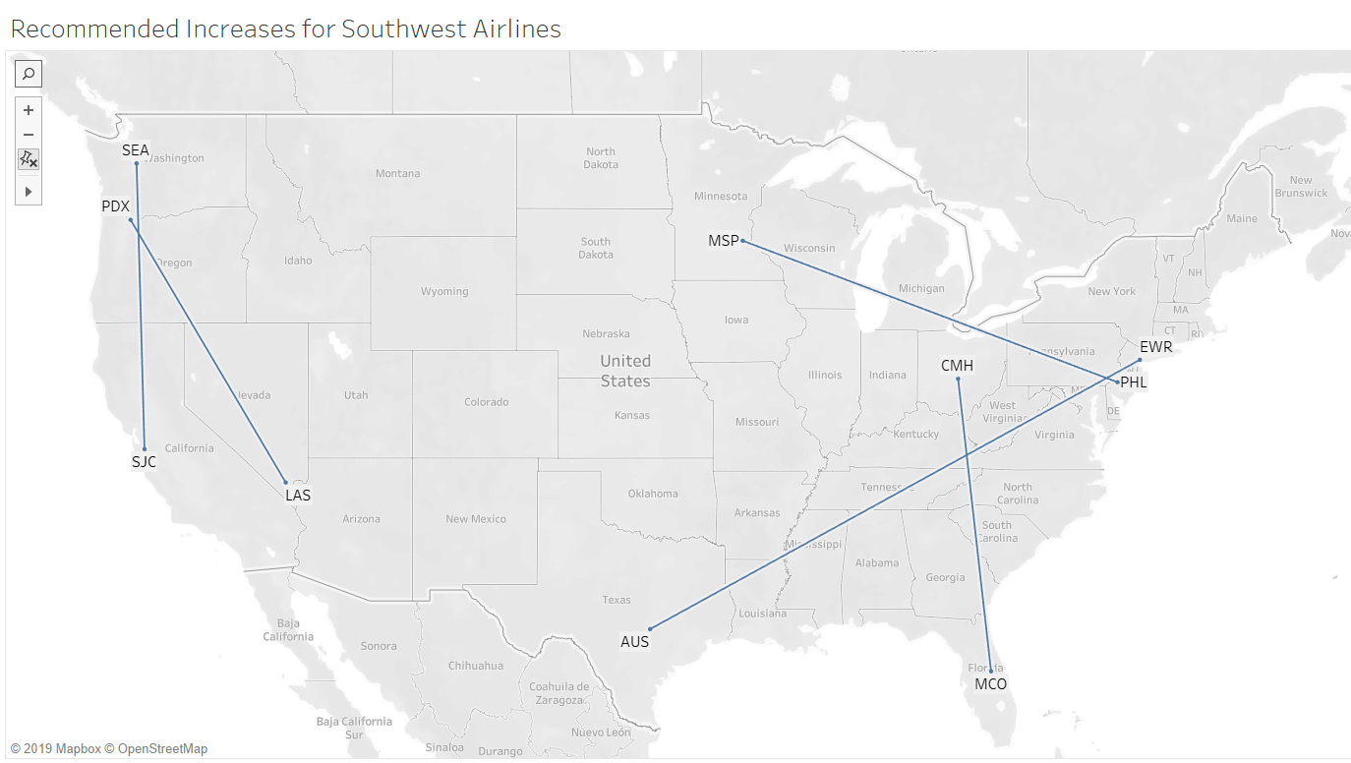

Slide 20
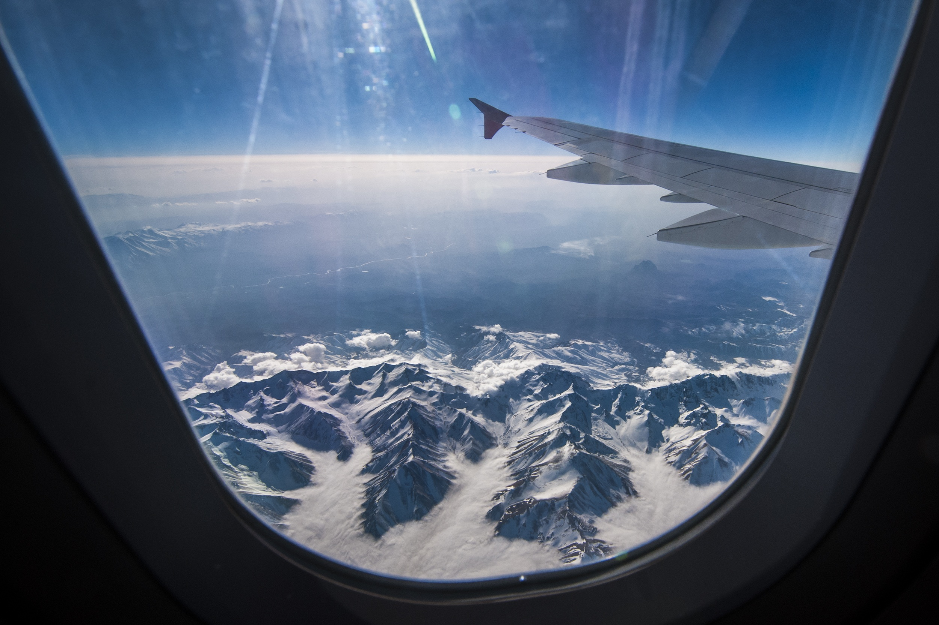



Key Takeaways

Slide 21
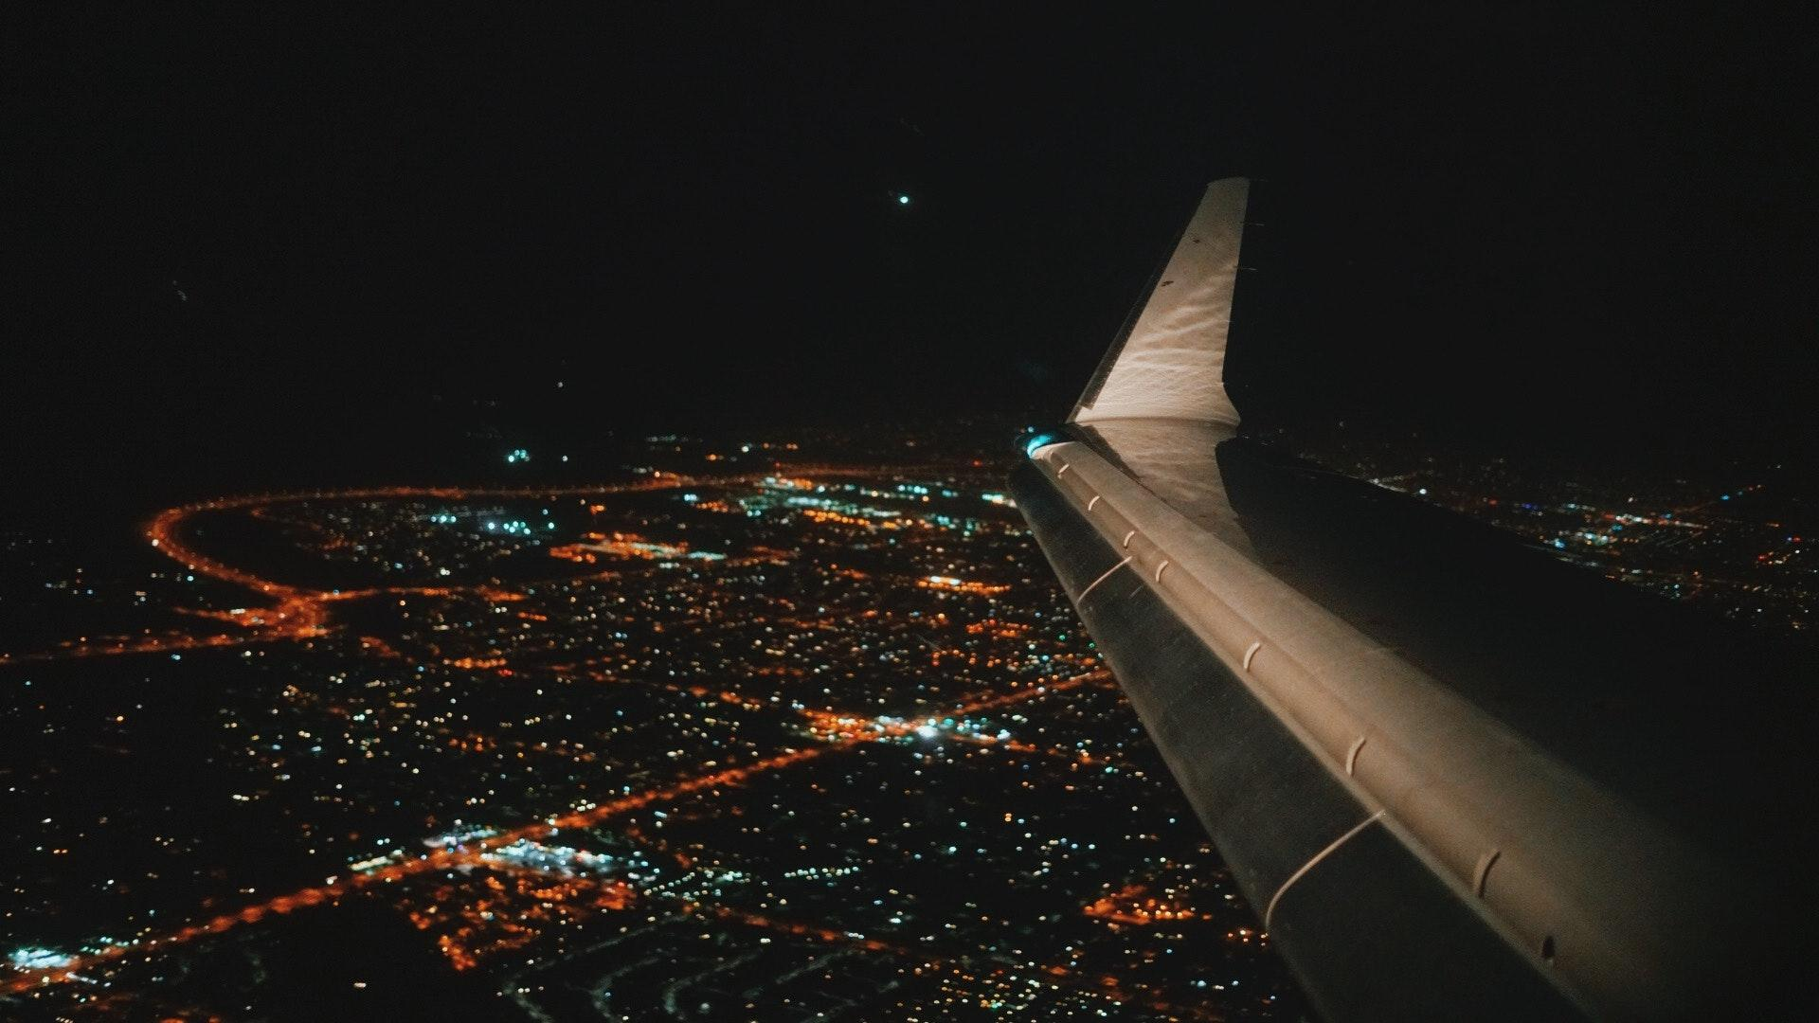
Key Takeaways
Future Work
Future Work
Recommend entirely new routes for airlines to increase total market share
Increase routes during Holidays and special events to capitalize on expected increase in demand
Gather data for overbooked flights and tie it with delays and demand to help the route planning team

Slide 22



Any Questions?

Slide 23

Team Rocket’s Blasting off Again!!!!

Slide 24
Appendix

Slide 25
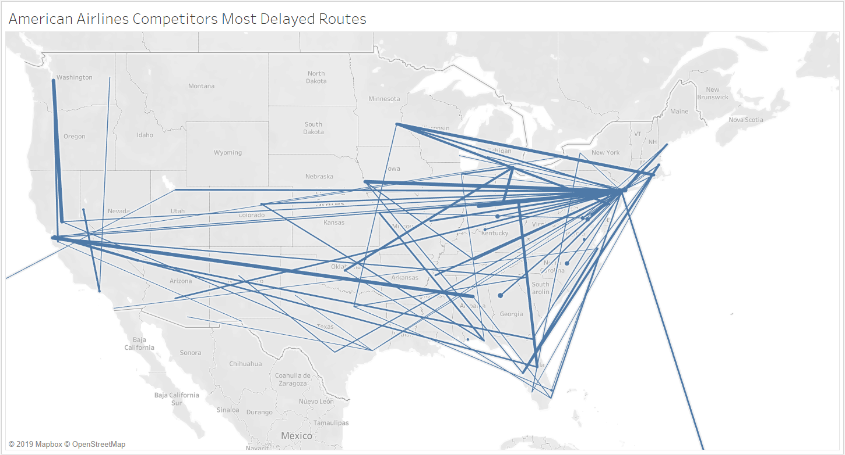

Slide 26
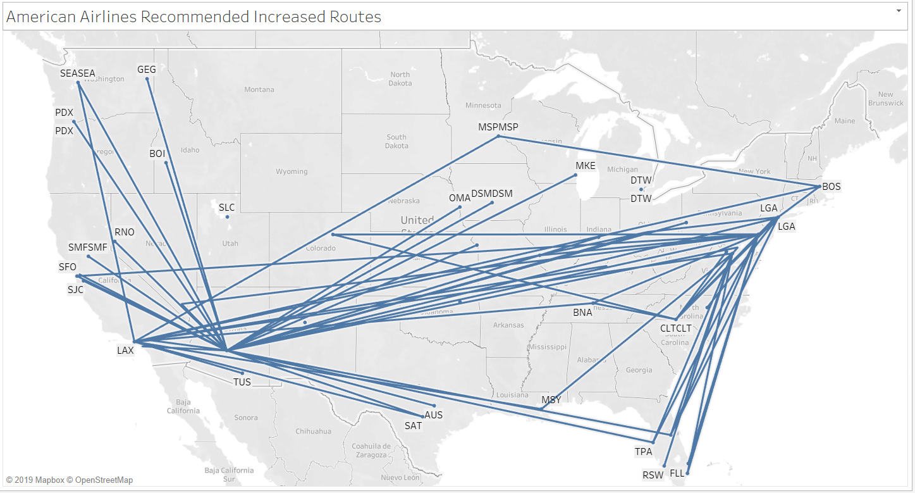

Slide 27
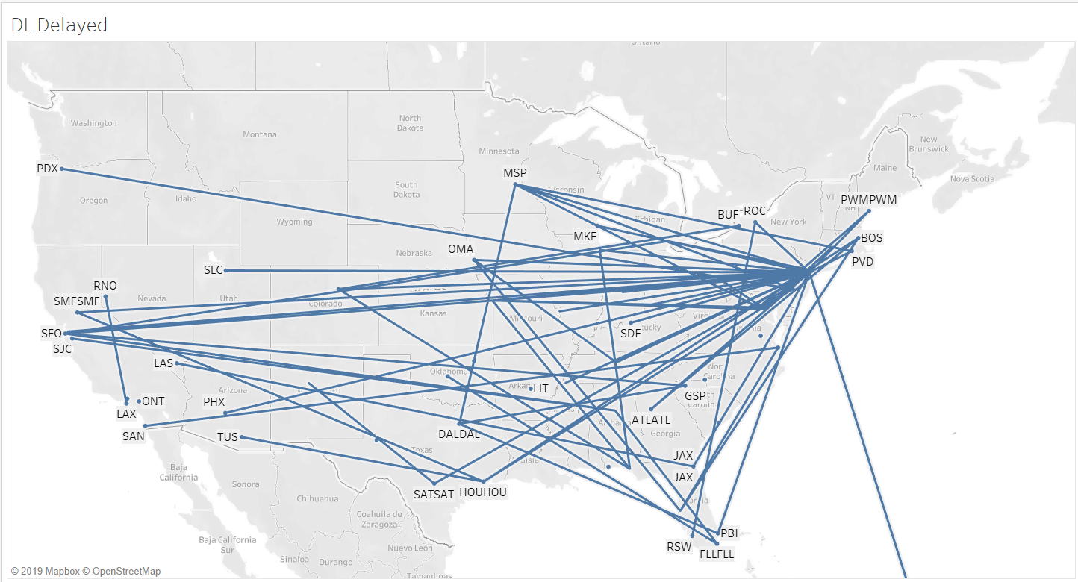

Slide 28
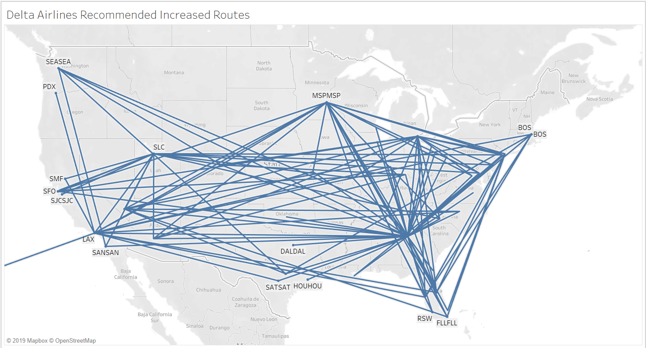

Slide 29
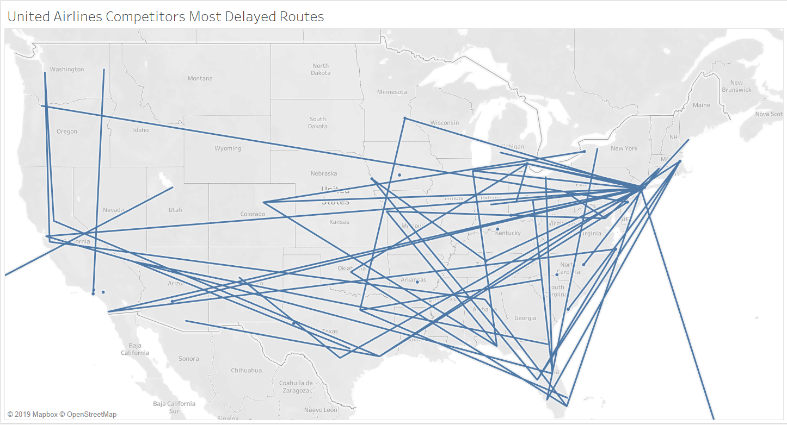

Slide 30
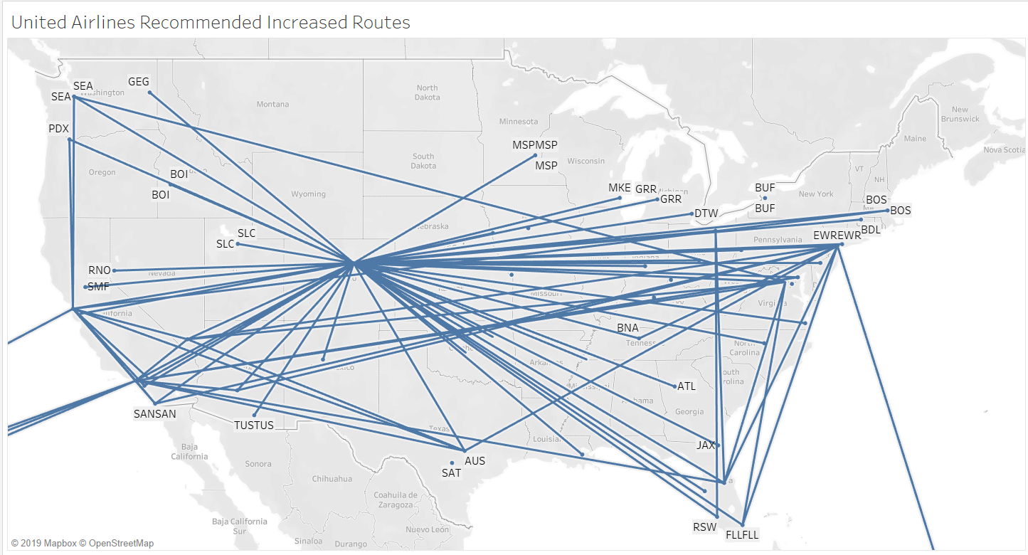

Slide 31
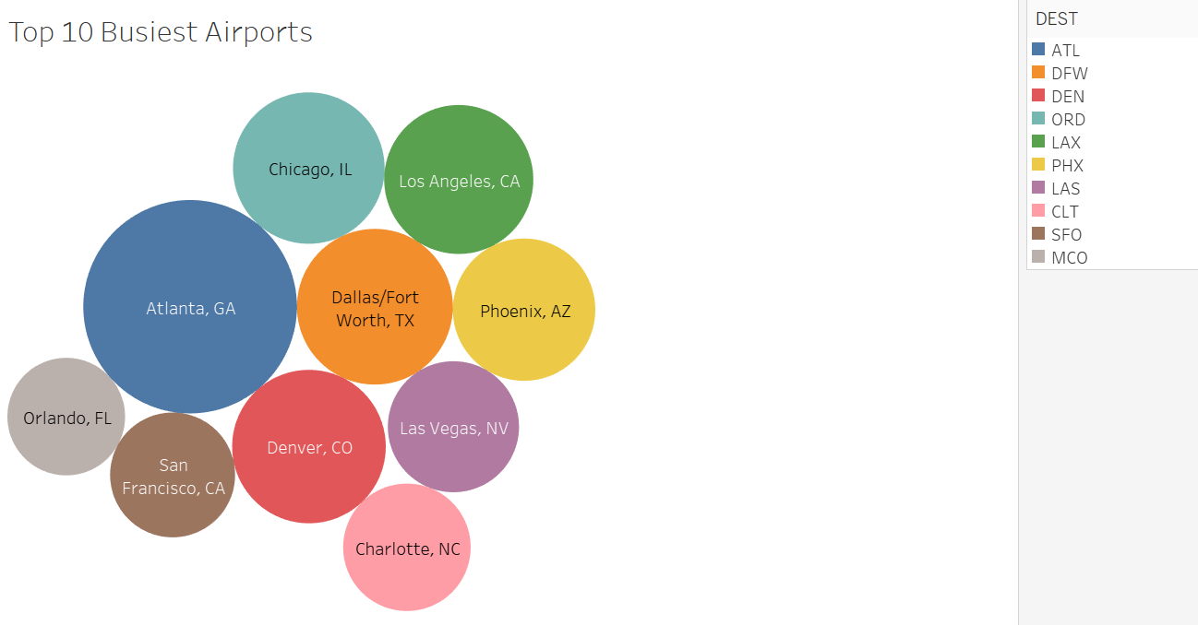

Slide 32
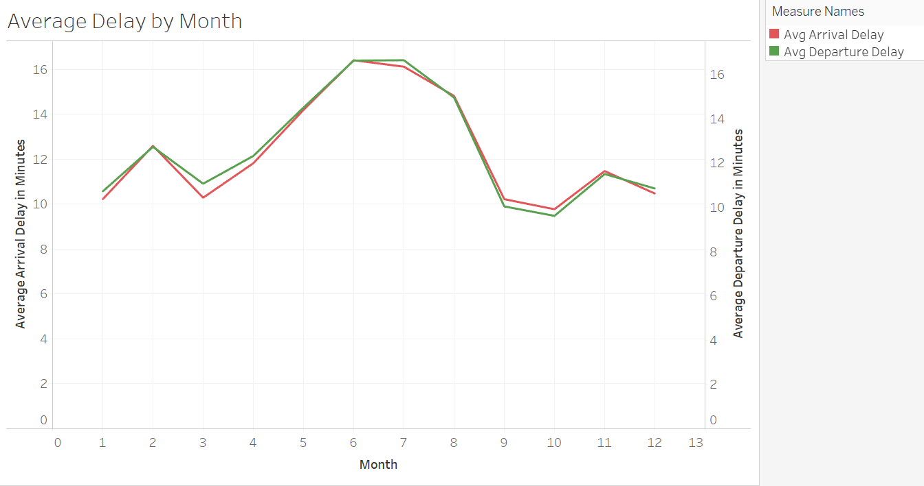

Slide 33
